Slide 1
Community-based Mapping and Monitoring of Water Sources in Somaliland: An integrated approach combining Citizen Science and Forecast-based Financing
Bosse Sottmann, 2023, Masterthesis

Slide 2



Structure
Case Area
Concepts & Methods
Take Home
01
02
03
04
05
Problem
Results

Slide 3
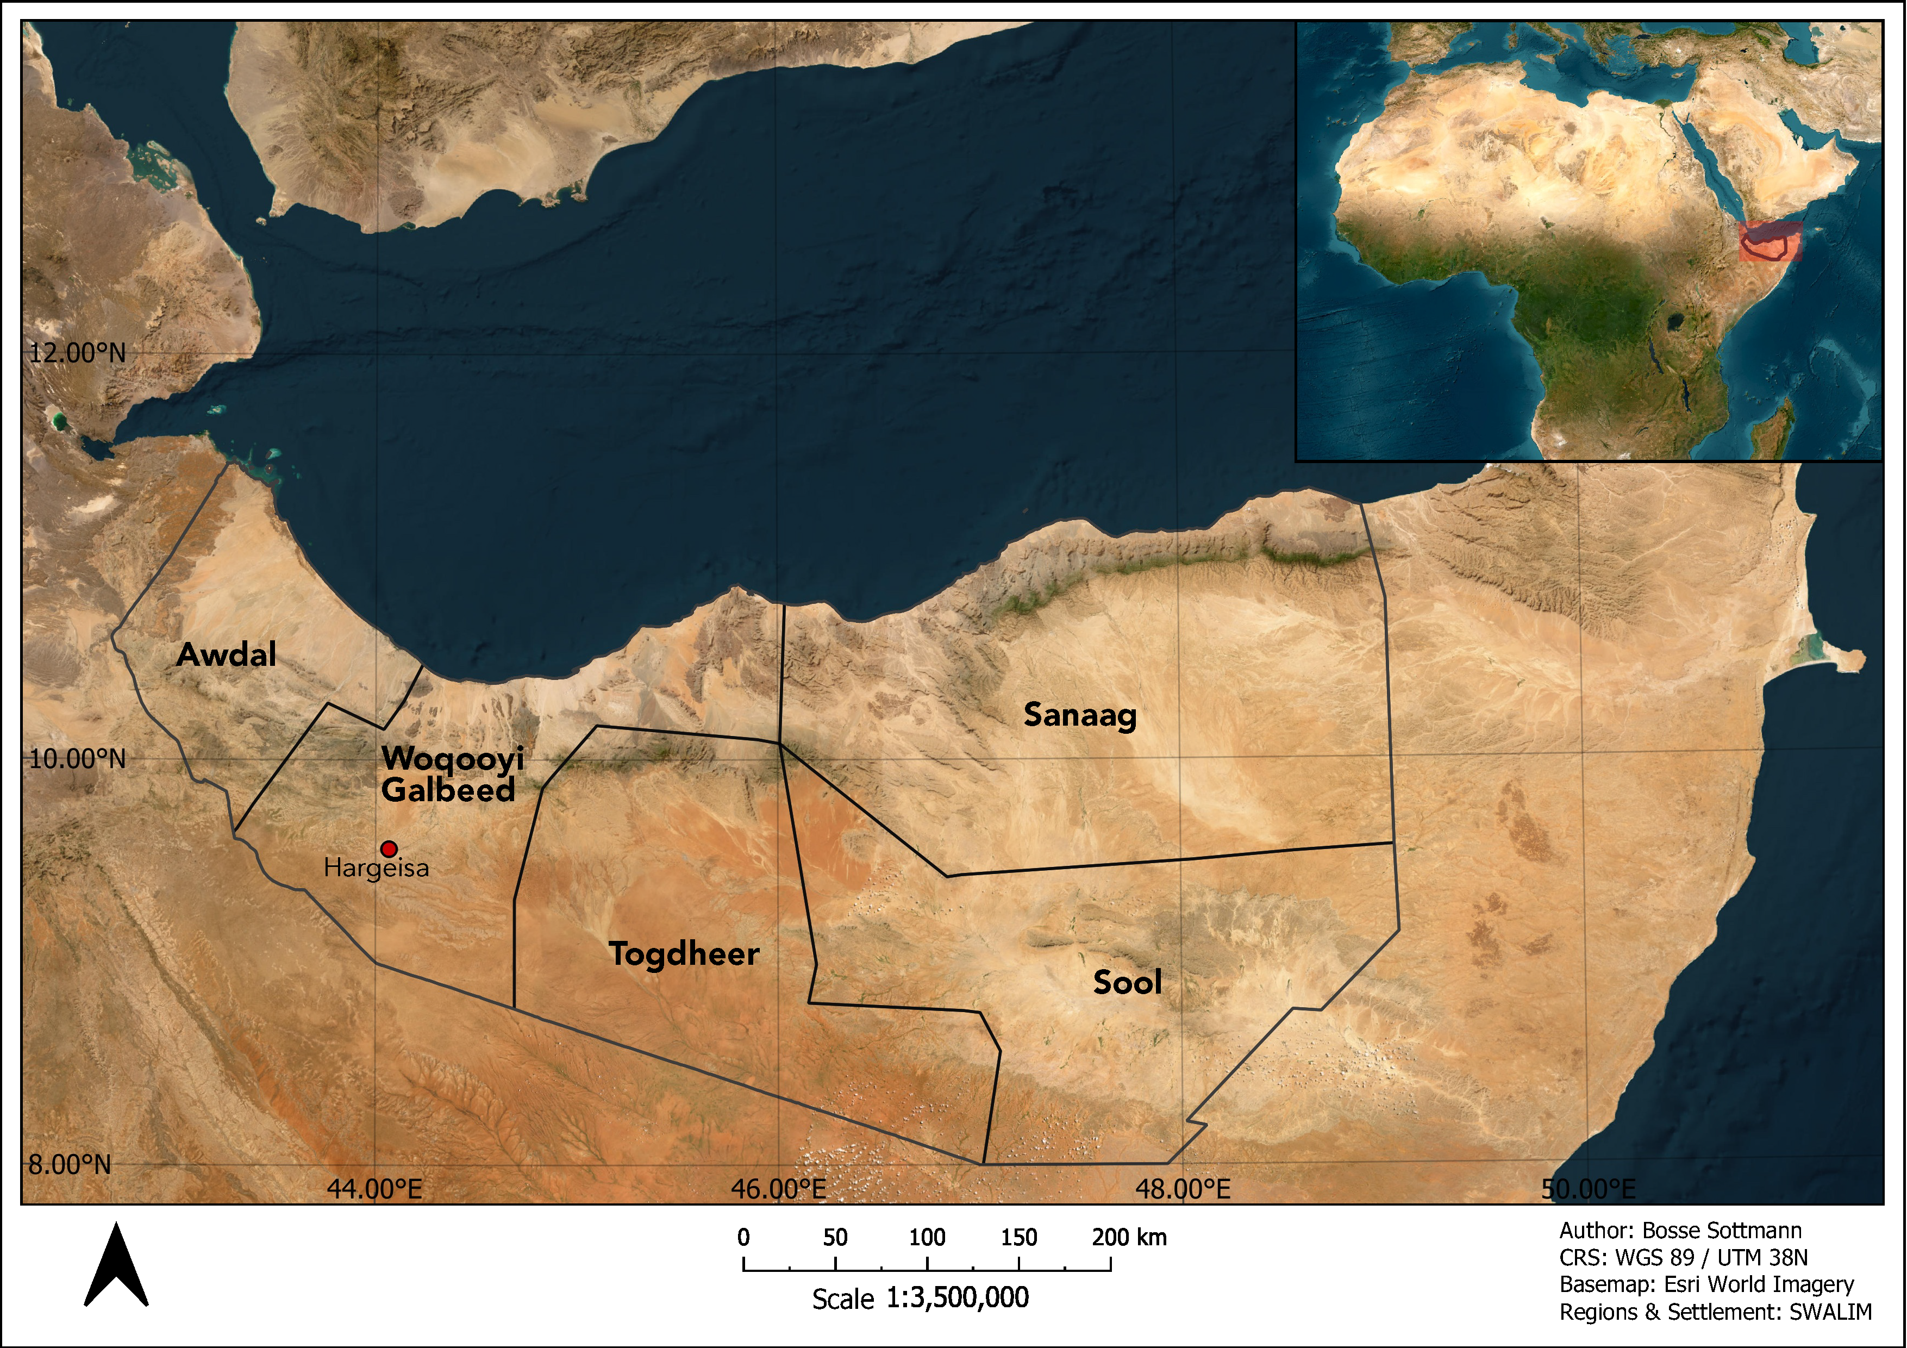
Bosse Sottmann - Masterthesis –2023 - 05.06.2023

Slide 4
177,000 km² 4.2 Mio pop.
1.5-2$ billiion/year
Water Resources
Conflict & Hazards
Network Coverage & Equipment
Knowledge
Notes:
02.02.2022 bis 08.03.2022 (zwei Mal erhoben)
Topkategorien: Kunst, Theater und Konzert (Achtung: bei Eventfinder durchaus mehr möglich, nur das erste gezählt)
50% auf 15 Veranstaltungsorte (top 3: Kunsthalle, Museum Zeughaus, Preiss-Engelhorn-Museen)
Daueraustellungen wurden für jeden Tag einzelnd gezählt

Slide 5
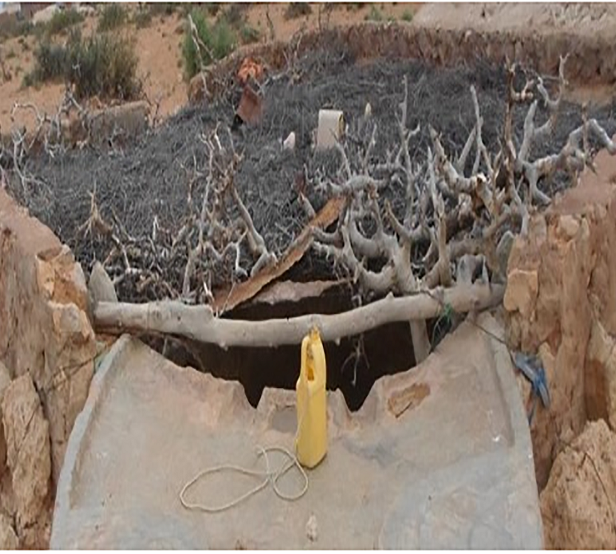
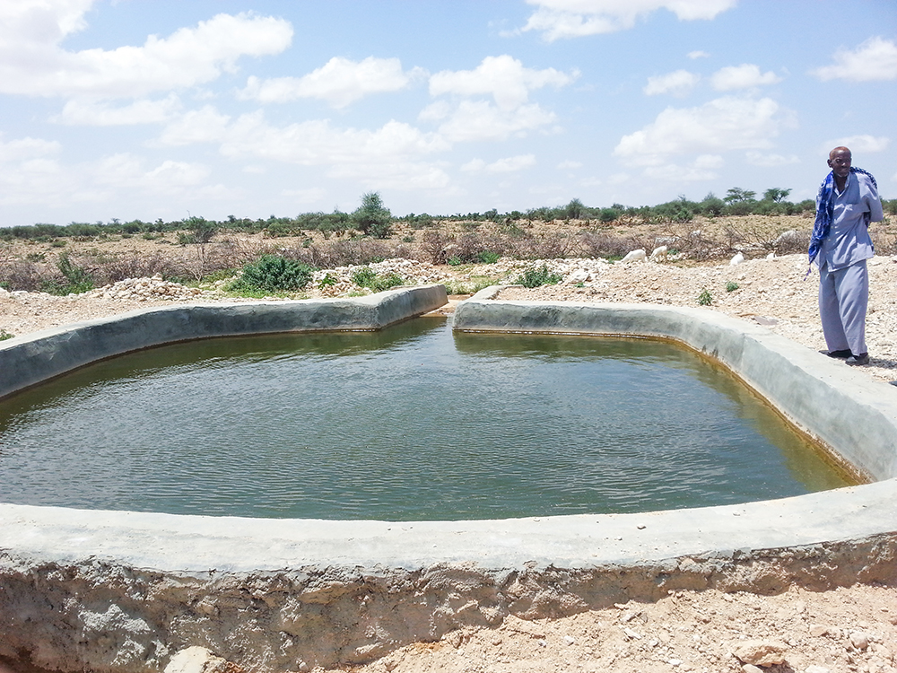
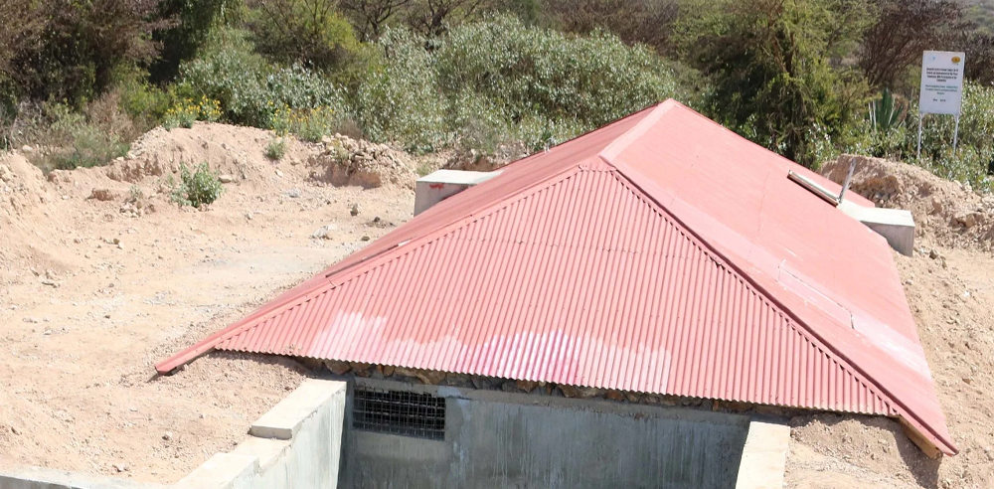
Water Sources - Berkads
Mafuta et al. (2021, p. 5)
The Pharo Foundation (2020)

Slide 6
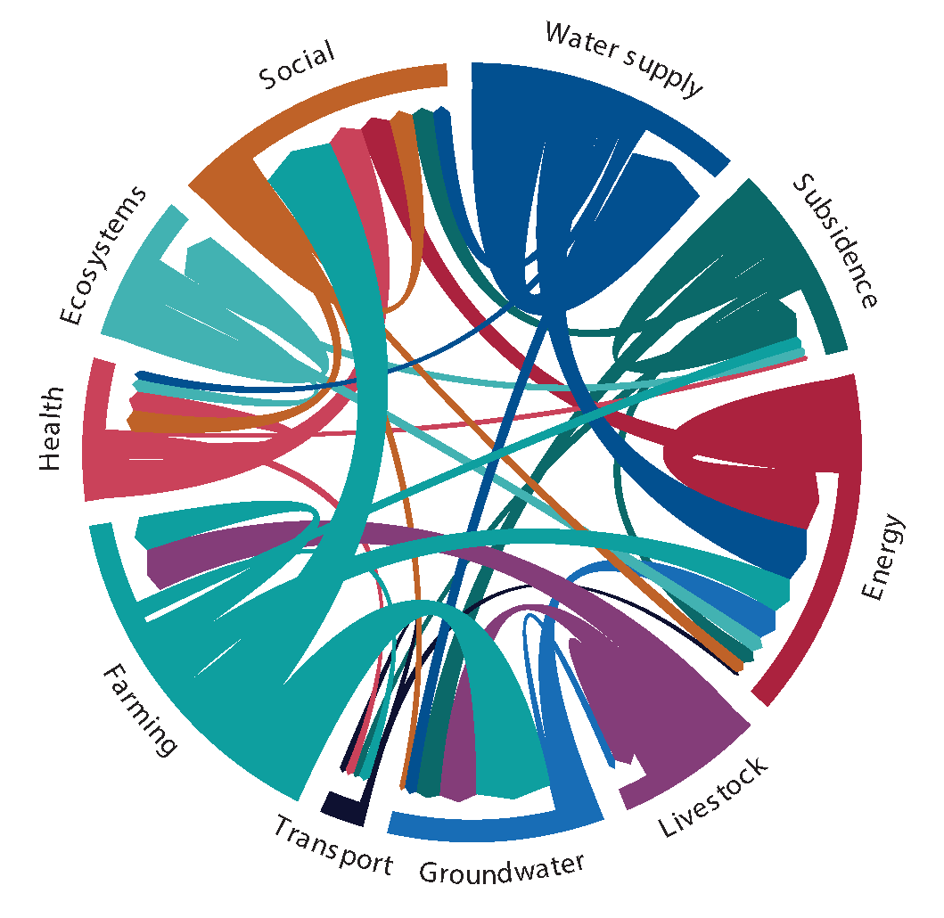
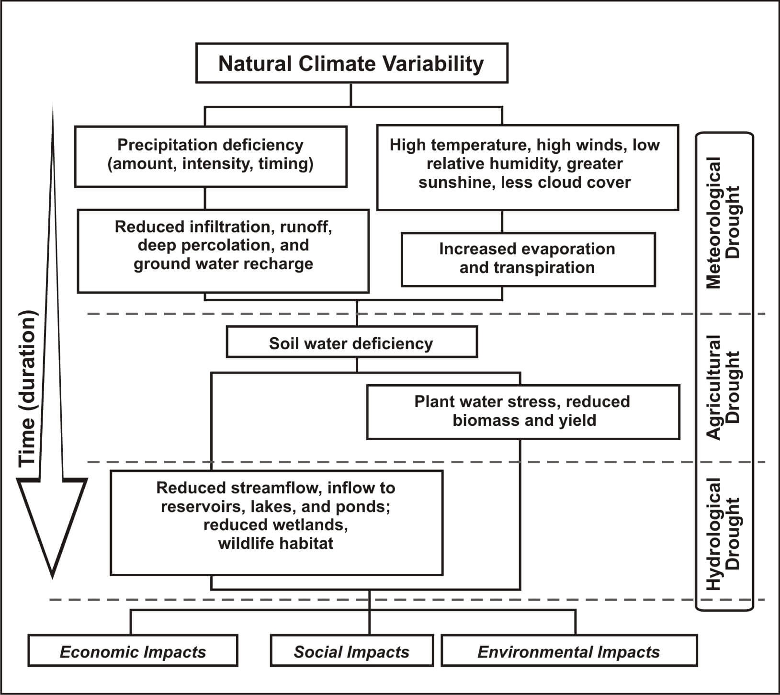
Drought
UNDRR (2021,p. 47)
NDMC (2023a)
Notes:
Multi layered
A lot of different stages
Lots of definitions

Slide 7
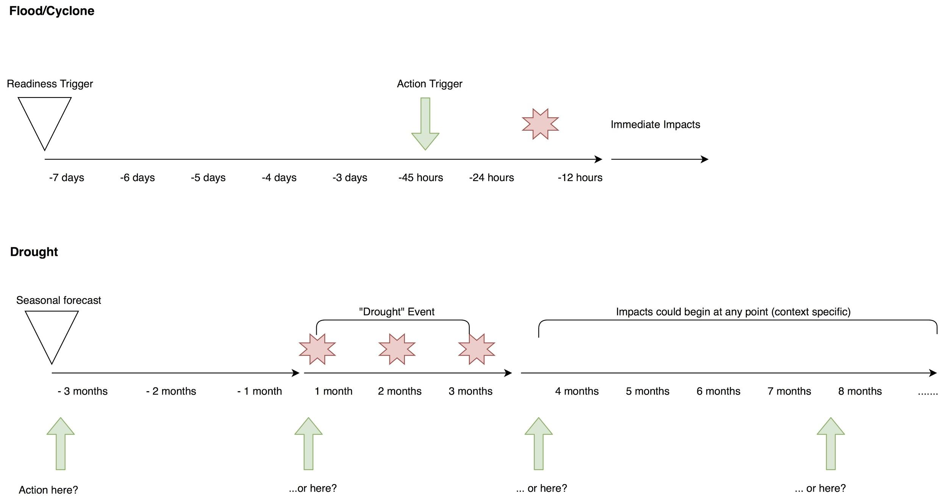
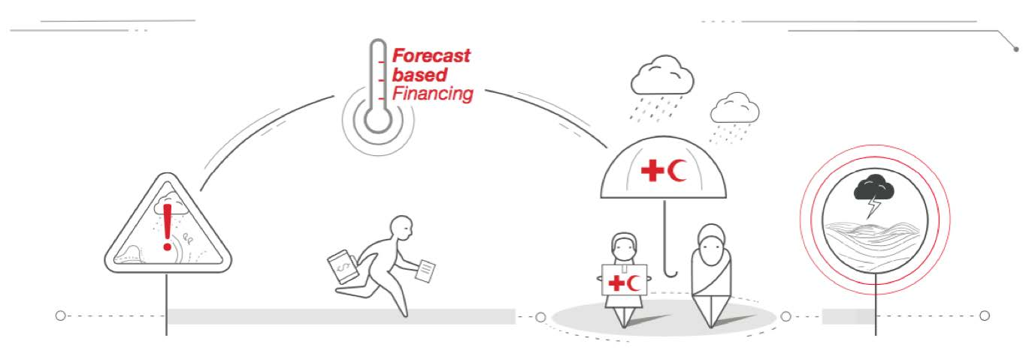
Forecast based Financing
RCRC (2020)
RCRC (2020)
Notes:
EAP
RISK = f(Hazard, Exposure, Vulnerability) where Vulnerability = f(Coping Capacity, Adaptivity Capacity)

Slide 8
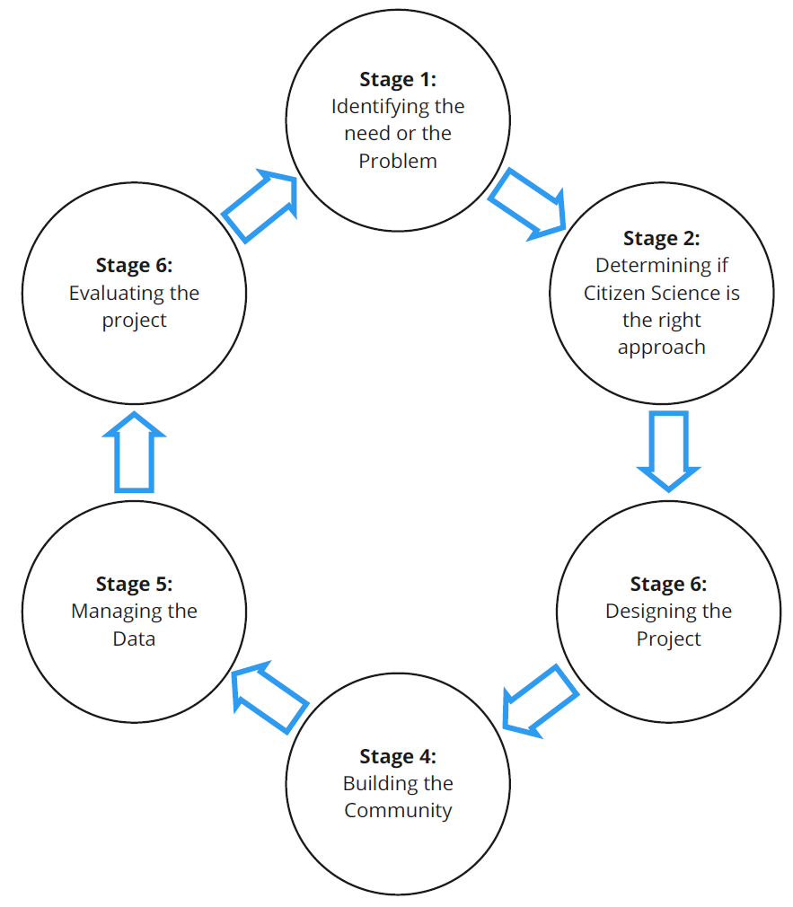
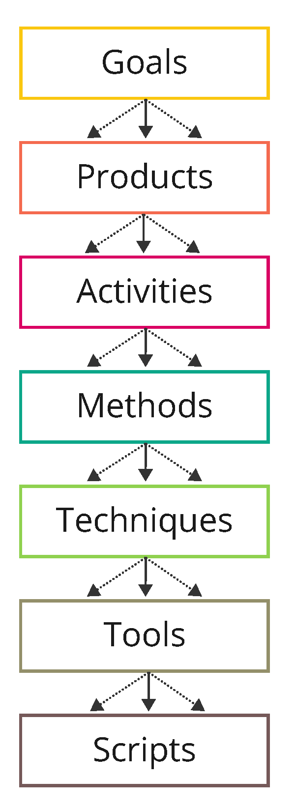
Methodology:
Citizen Science
Exploratory, iterative Case Study research design
Mixed method approach – expert interviews, data & document analysis
Based on Six-Stage-Framework and Seven-layer-model of collaboration & 15+ other frameworks and projects

Slide 9
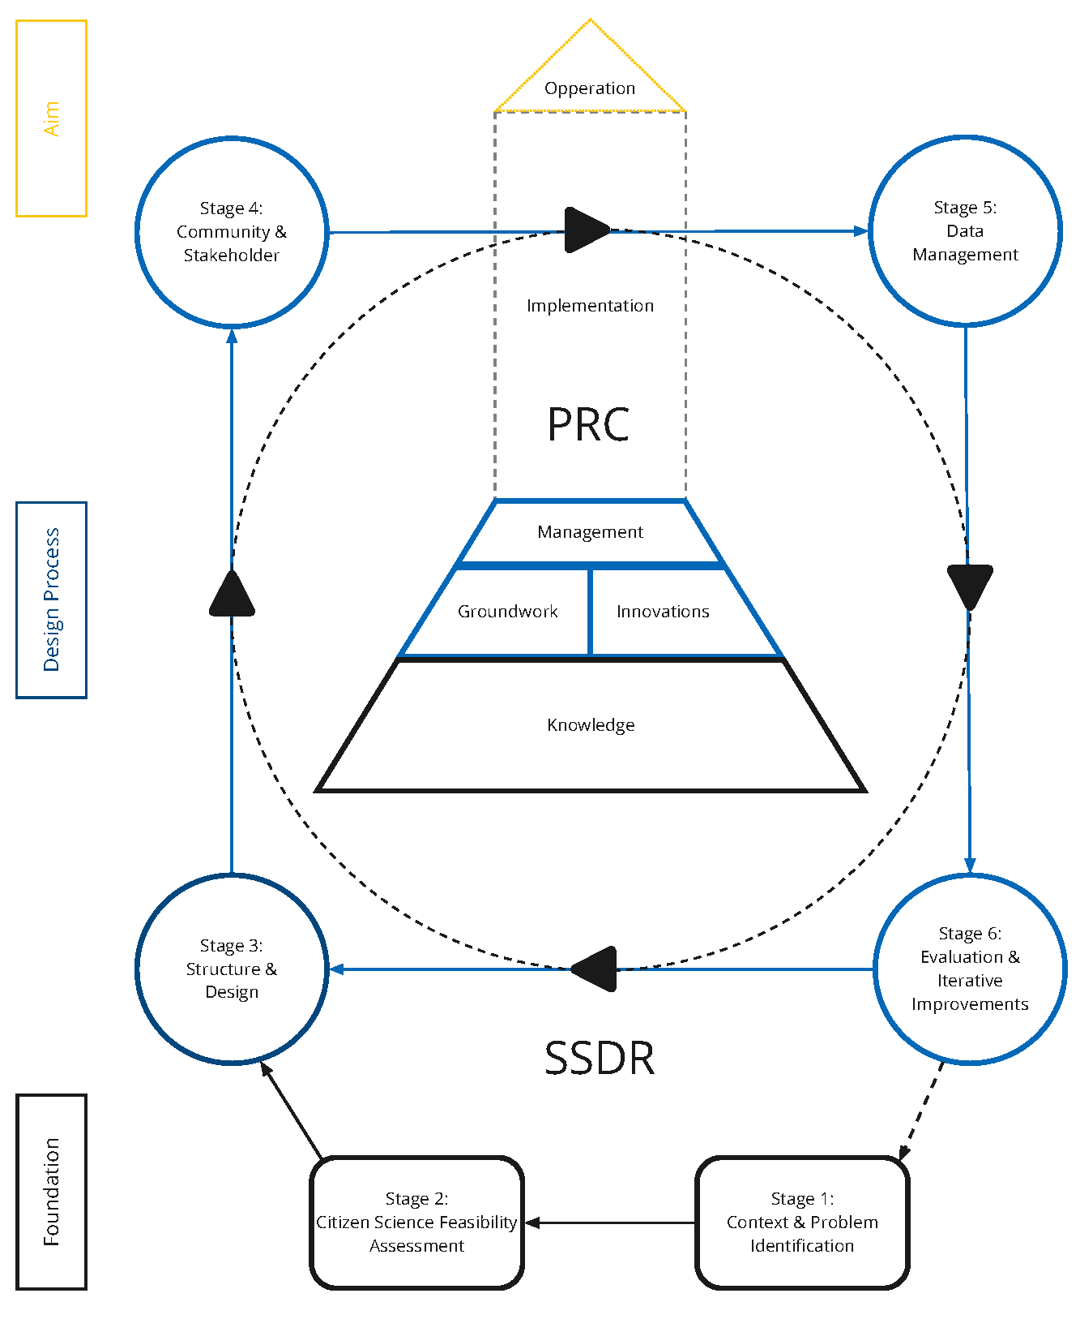
Results:
Six-Stage-Design Roadmap & Project Requirements Catalogue
Notes:
Groundwork -> Policy (Integrated Water Resource Management)
Innovations -> Measuring, sending, etc.,
Management -> which decision need to be made

Slide 10
TAKE HOME

Slide 11
References
Briggs, R. O., Kolfschoten, G., de Vreede, G.-J., Albrecht, C., & Dean, D. R. (2009). A Seven-Layer Model
of Collaboration: Separation of Concerns for Designers of Collaboration Systems, 16.
Fraisl, D., Hager, G., Bedessem, B., Gold, M., Hsing, P.-Y., Danielsen, F., Hitchcock, C. B., Hulbert, J. M.,
Piera, J., Spiers, H., Thiel, M., & Haklay, M. (2022). Citizen science in environmental and ecological
sciences. Nature Reviews Methods Primers, 2(1), 1–20. https://doi.org/10.1038/s43586-022-
00144-4
LIFE. (2017). LIFE works with Local Village to Build Berkad. Local Initiatives for Education (LIFE). Retrieved
April 15, 2023, from http://localinitiativesforeducation.us/news/2017/11/16/life- workswith-
local-village-to-build-berkad
Mafuta, W., Zuwarimwe, J., & Mwale, M. (2021). Universal WASH coverage; what it takes for fragile
states. Case of Jariban district in Somalia. PLOS ONE, 16, e0247417. https://doi.org/10.1371/
journal.pone.0247417
NDMC. (2023a). Types of Drought. In National Drought Mitigation Center. University of Nebraska-Lincoln.
Retrieved March 7, 2023, from https : / / drought . unl . edu / Education / DroughtIn - depth /
TypesofDrought.aspx
RCRC. (2020). Forecast-based Financing and Early Action for Drought.
The Pharo Foundation. (2020). Improved Berkad. Retrieved April 15, 2023, from www.pharofoundation.
org/wp-content/uploads/2020/02/Ilma-Dado-Berkad-1-scaled.jpg
UNDRR. (2021). Special report on drought 2021. United Nations. p. 47.

